Slide 1
Lecture 12 Fuzzy Logic and Expert Systems
CS 180 – Intelligent Systems
Dr. Victor Chen
Fall 2022

Slide 2
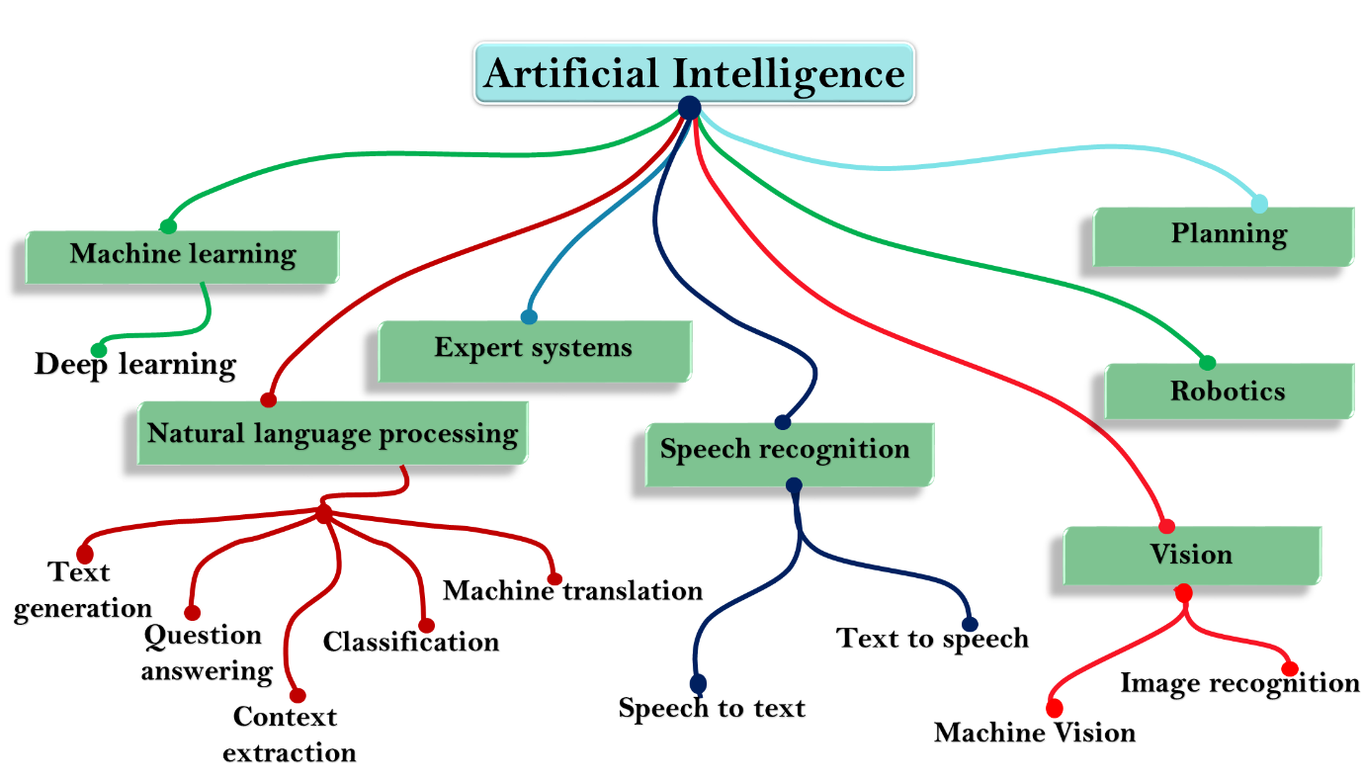
Three AI areas
Knowledge Learning
Machine learning/Neural networks
No closed-form math expression
Optimization
Search
Adversarial search
Genetic algorithms
Knowledge Reasoning
Bayesian inference
Fuzzy logic

Slide 3

What is a FUZZY LOGIC?
Fuzzy Logic is an approach to computing based on “degrees of truth” rather than the usual “true or false” (1 or 0) boolean (binary) logic, on which the modern computers are based.

Slide 4
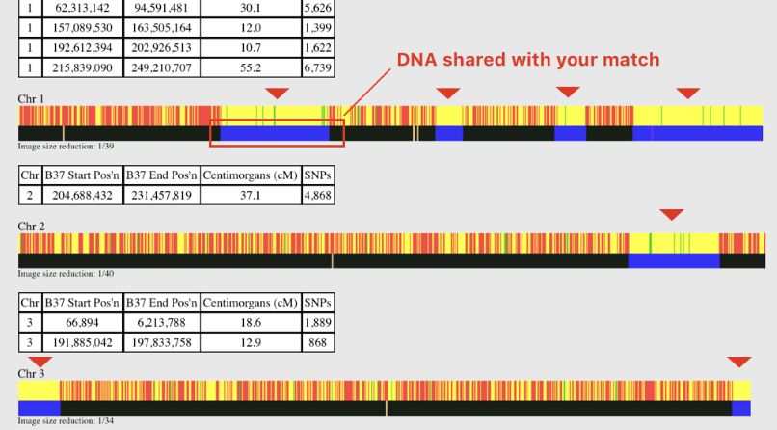
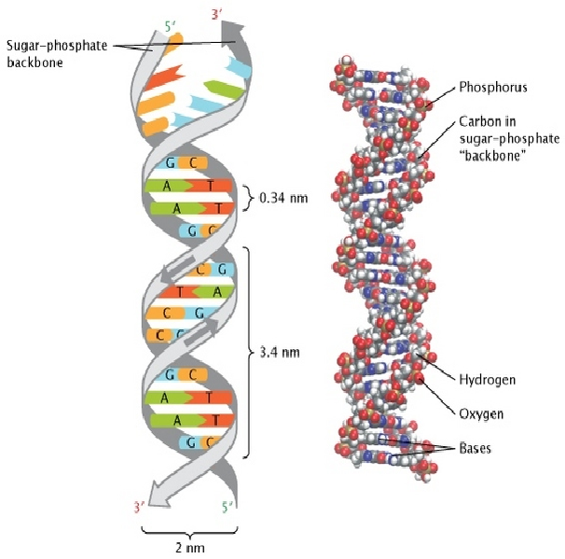
DNA match/search using fuzzy Logic
To find approximate matches for a search key

Slide 5


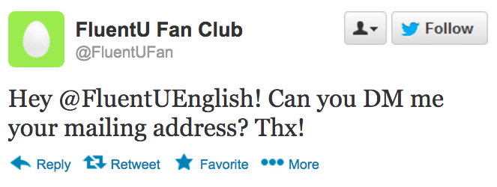
Text match/search using fuzzy Logic
To find approximate matches (slang, misspelling, abbreviation on social media) for a search key

Slide 6
Other fuzzy logic applications
To match customers to identify the buying behavior
For customer address matching
To match file paths
To detect plagiarism (text re-use)
For spam filtering

Slide 7
Fuzzy Sets (Fuzzy Logic) vs Crisp Sets (Boolean Logic)
Crisp Set → Classical sets which have distinct objects. For e.g.,
A = {apples, oranges, mangoes}
B = {2, 4, 6, 8}
(each element has a membership degree of 1)
Fuzzy Set → The membership degree can be 0<μ(x) < 1
A = { 0.4 + 0.6 + 0.7 }
train
car
cycle
where is a separator, and ＋ is the logic OR
train has a membership degree of 0.4
If the membership degree is 0, it means that the element is not associated with set A.
If the membership degree is 1, it means that the element is strongly associated with set A.
Notes:
Fuzzy Logic is so important in real world scenario because most of the scenarios do not have distinct values, but are based on approximation. For e.g., the no. of RBC in your blood cannot be actually counted, but we can always have an estimated value. Or, the growth of bacteria in a particular environment can only be predicted but we cannot have the correct value.
Fuzzy logic operates on the concept of membership and the degrees of membership, which ranges from 0 to 1.

Slide 8
FUZZY THEORY
Boolean Logic (Crisp Sets)
Is Bob honest?
Fuzzy Logic (Fuzzy Sets)
True
(1)
False
(0)
Is Bob honest?
Very honest
Honest
Honest (sometimes)
dishonest
(1)
(0.8)
(0.5)
Membership value
μ_{A} (x) = 1, iif x ε A
= 0, iif x ε A
(0)
(membership value/degree)
Membership value
μ_{A} (x) ε [0, 1]

Slide 9
Definition of Fuzzy Sets
A fuzzy set A is defined by using
A={ x |μ(x)}
where μ(x) is a membership function.
The range of μ(x) is [0,1]. We cannot say clearly if x is in A or not when 0<μ(x) < 1.
A fuzzy set A is described as follows:
A = μ_{A}(x₁)/x₁+ μ_{A}(x₂)/x₂+…+ μ_{A}(x_{N})/x_{N}
where / is a separator, and ＋ is the logic OR.

Slide 10
Operations on fuzzy sets
Meaning | Set notation | Membership function
Equivalence | A = B | μ_{A} (x) = μ_{B} (x)
Implication | A ⊆ B | μ_{A} (x) ≤ μ_{B} (x)
Complement (negation) | A | μ (x) = 1− μ (x) _{A} A
Union | A∪ B | μ_{A∪B} (x) = max{μ_{A} (x), μ_{B} (x)}
Intersection | A∩ B | μ_{A∩B} (x) = min{ μ_{A} (x), μ_{B} (x)}

Slide 11

Operations of fuzzy sets
Meaning | Set notation | Membership function
Difference | A − B or (A∩B) | μ_{A-B} (x) = min{ μ_{A} (x), ¬μ_{B} (x)}
Sum | A + B | μ_{A+B} (x) = μ_{A} (x) +μ_{B} (x) –(μ_{A} (x) ⋅ μ_{B} (x))
Product | A ⋅ B | μ (x) = μ_{A} (x) ⋅ μ_{B} (x) _{A}⋅ _{B}
Bounded sum | A⊕ B | μ_{A}⊕_{B} (x) = min{1, μ_{A} (x) + μ_{B} (x)}
Bounded difference | A B | μ_{A B} (x) = max{ 0 , μ_{A} (x) –μ_{B} (x)}

Slide 12
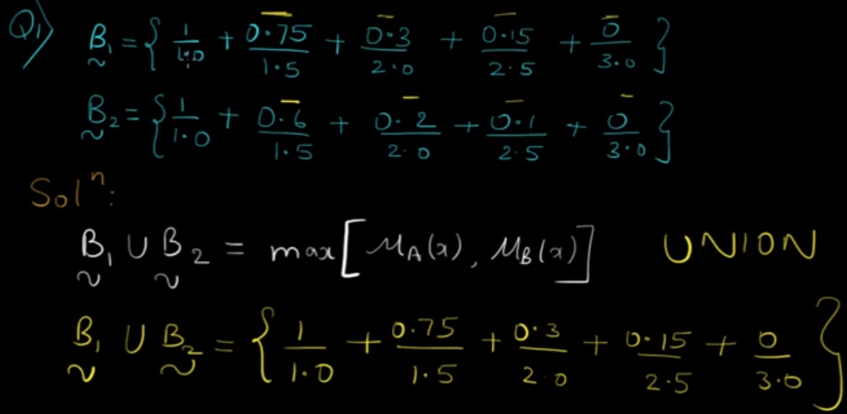
Union

Slide 13
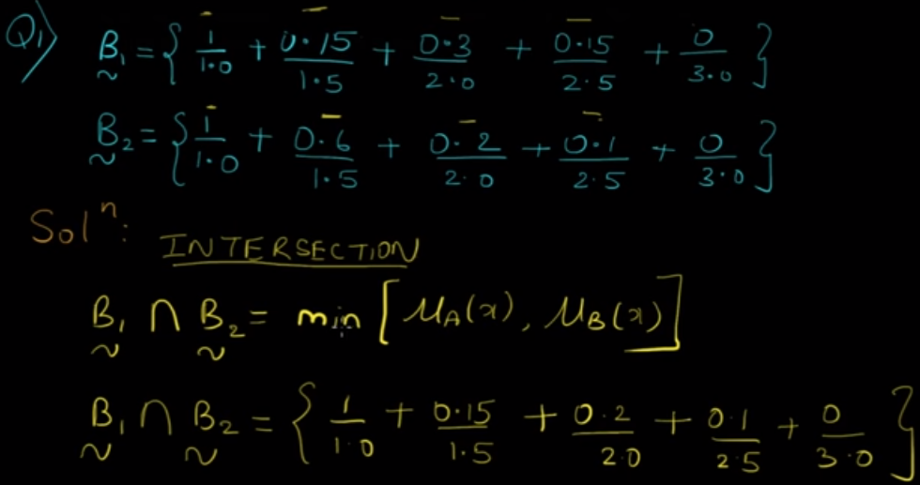
Intersection

Slide 14
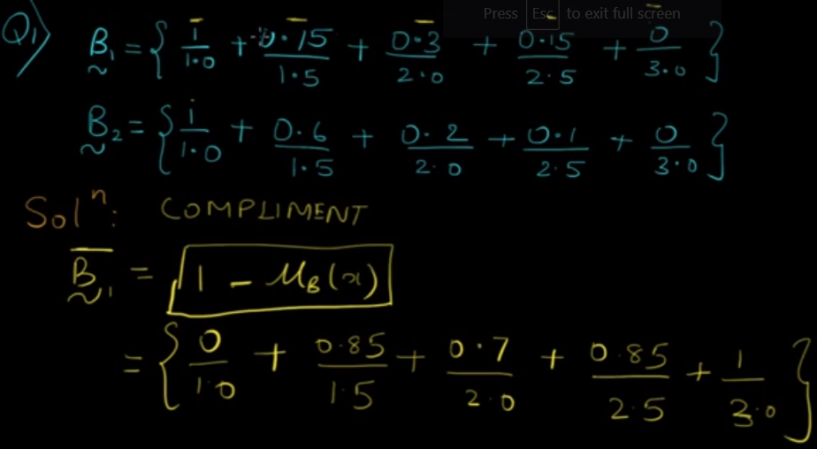
Complement

Slide 15
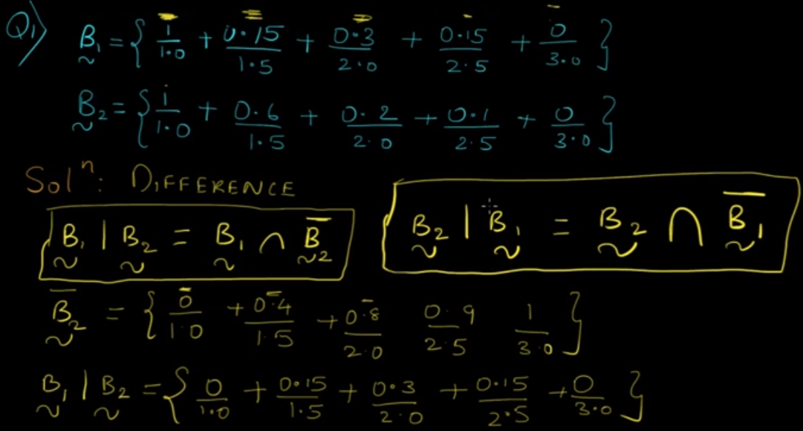
Difference

Slide 16
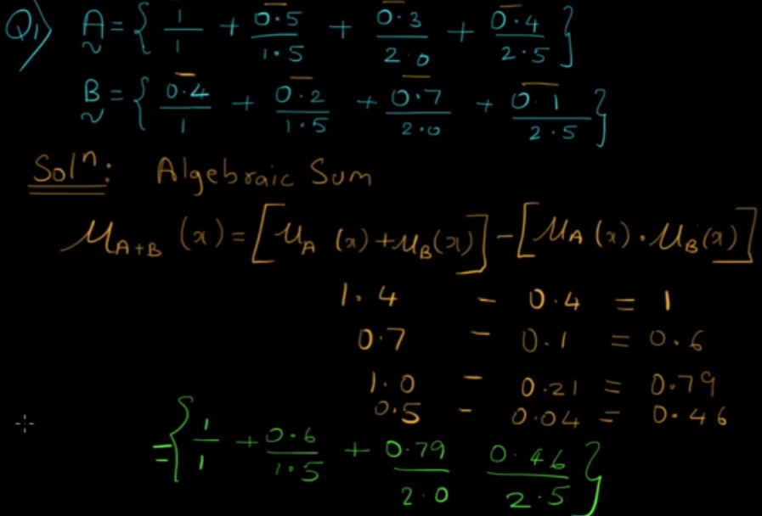
Sum

Slide 17
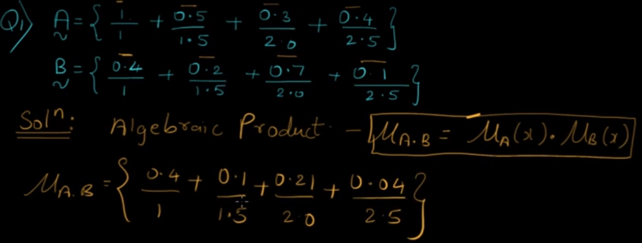
Product

Slide 18
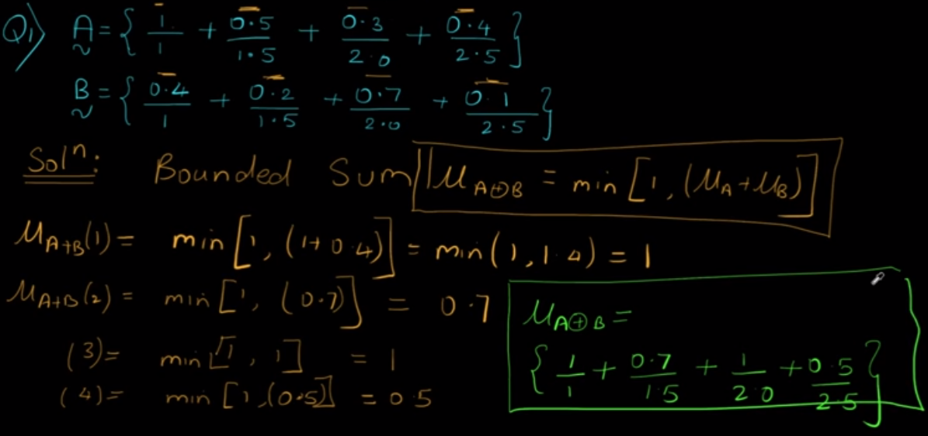
Bounded Sum

Slide 19
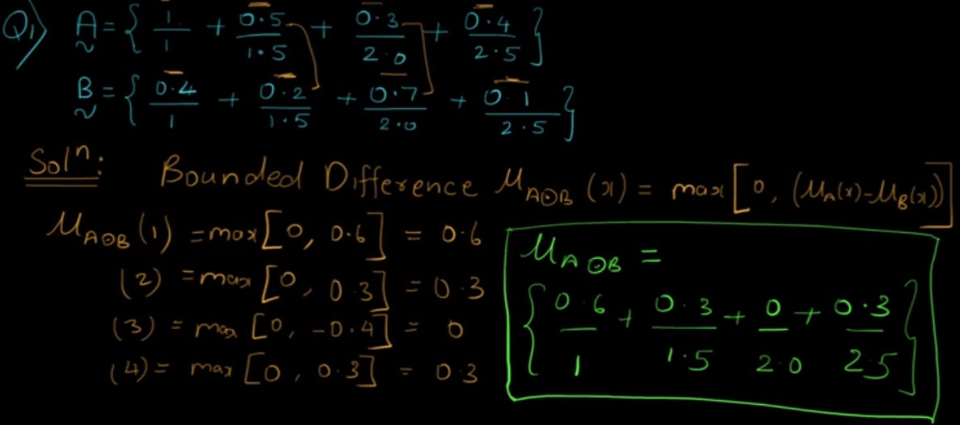
Bounded Difference

Slide 20
Practice
All the people: X={Alice, Bob, Charles, Eric, William}
Fuzzy sets A=“young persons” and B=“tall persons” are defined by
A = 0.4/Alice + 0.6/Bob + 0.8/Charles +1.0/Eric + 0.9/William
B = 0.3/ Alice + 0.5/Bob +0.9/Charles + 0.6/Eric + 1.0/William
Who are the young or tall persons?
A∪B = 0.4/Alice + 0.6/Bob + 0.9/Charles + 1.0/Eric + 1.0/William
Who are the young and tall persons?
A∩B =0.3/ Alice +0.5/Bob +0.8/ Charles + 0.6/ Eric + 0.9/William
Who are tall and old persons?
B − A = B ∩ A
A = 0.6/Alice + 0.4/Bob + 0.2/Charles +0/Eric + 0.1/William
B − A = 0.3/Alice + 0.4/Bob + 0.2/Charles +0/Eric + 0.1/William

Slide 21
Fuzzy Numbers
Fuzzy numbers are fuzzy sets defined on real numbers
Given A = μ_{A}(x₁)/x₁+ μ_{A}(x₂)/x₂+…+ μ_{A}(x_{N})/x_{N} , if x_{1,} x_{2, …} x_{N} are real numbers and 0< μ_{A}(x_{i}) < 1, the A is a fuzzy number.
On the other hand, if for any x_{N} , μ(x_{N}) = 0 or 1, then A is a crisp number or crisp set

Slide 22
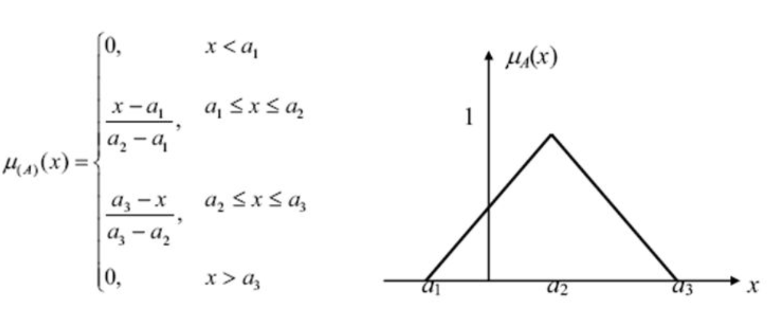
One example fuzzy number

Slide 23
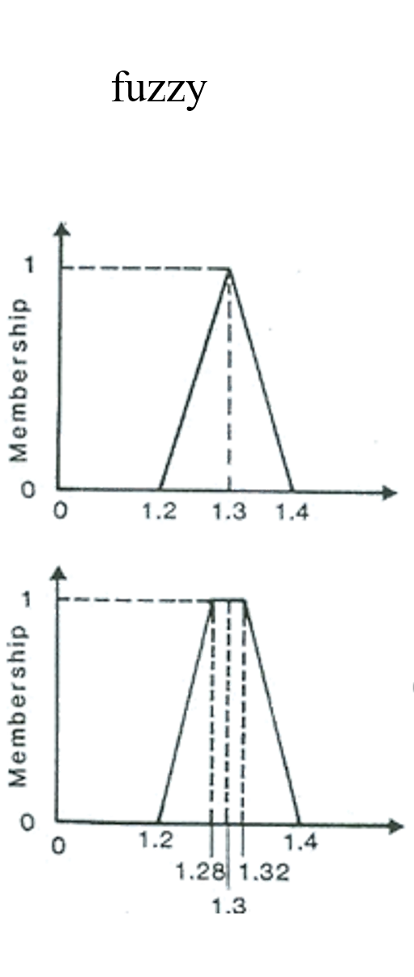
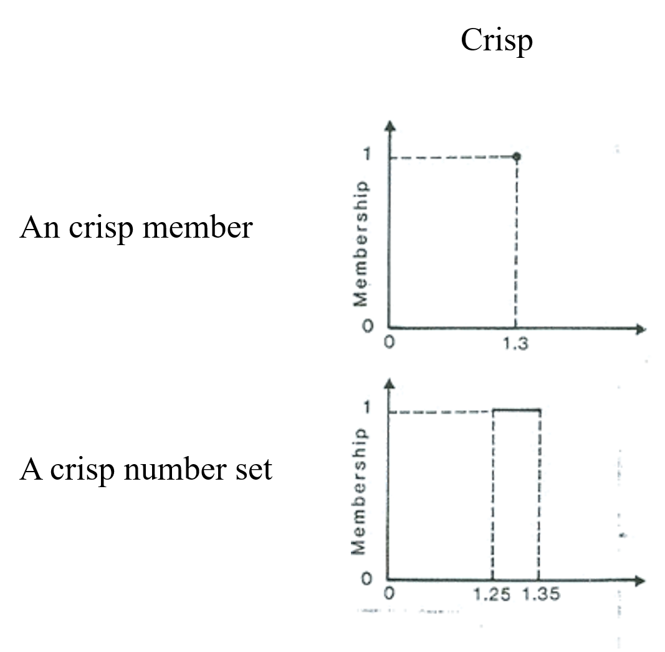
fuzzy numbers vs crisp numbers

Slide 24
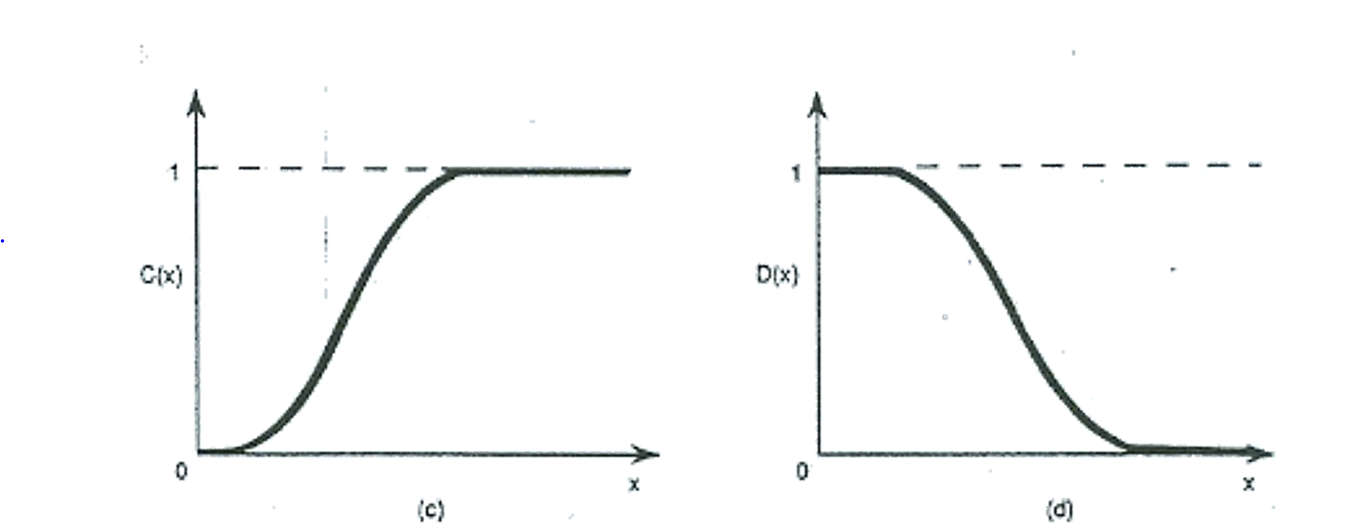
Cases of fuzzy numbers
Membership functions of fuzzy numbers can be unsymmetric
large number small number

Slide 25
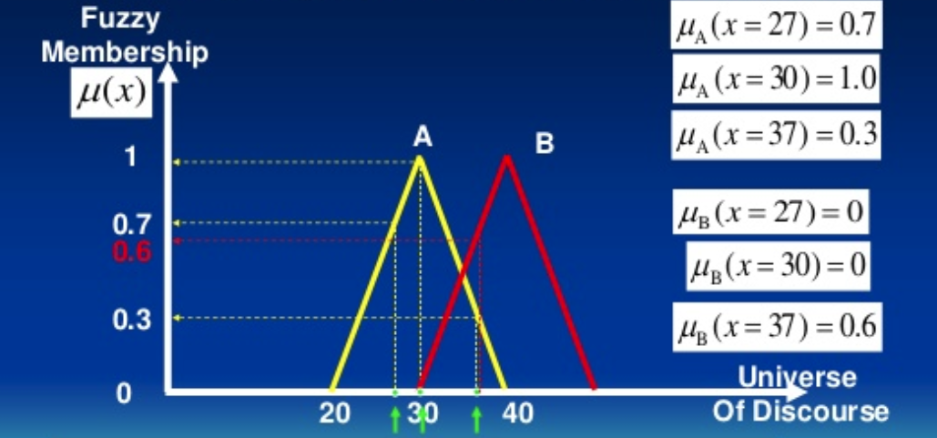
Two fuzzy numbers (each X has a membership value for each fuzzy number)

Slide 26
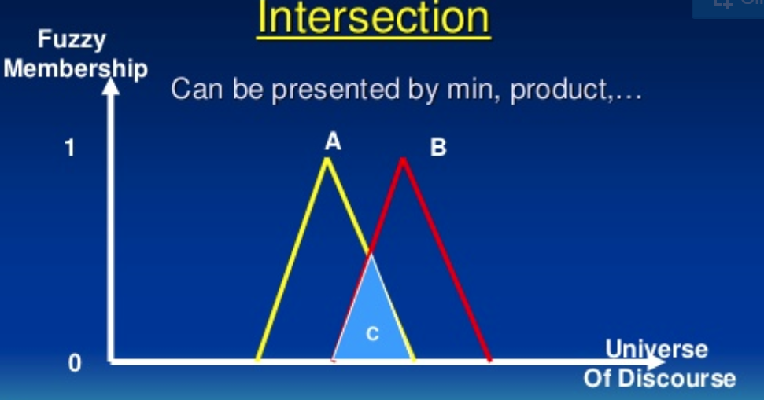
Intersection of fuzzy numbers

Slide 27
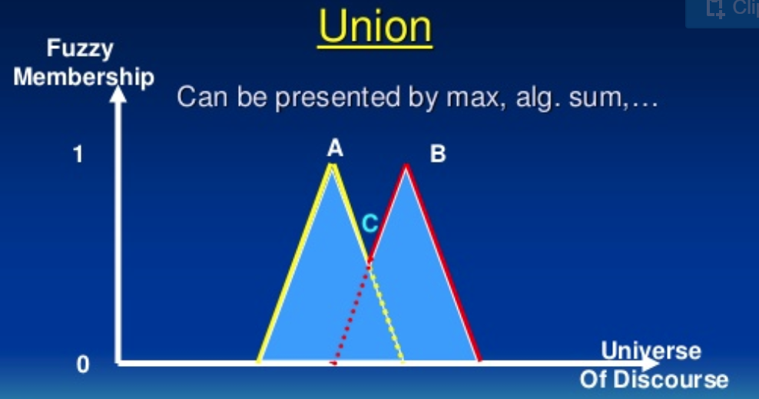
Union of fuzzy numbers

Slide 28
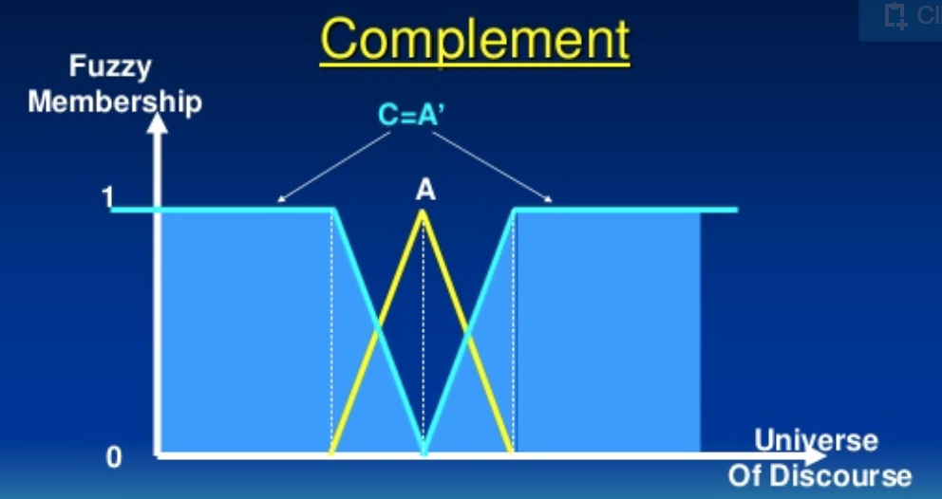
Negation (Complement) of fuzzy number

Slide 29
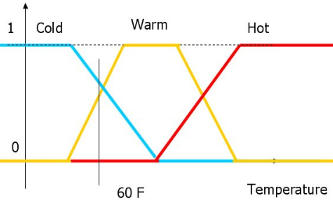
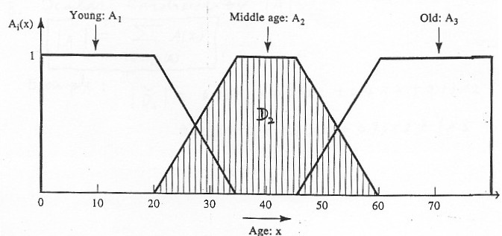
In Artificial Intelligence, the ultimate question is:
MACHINES THINK LIKE HUMAN
Humans think and reason in a way similar to fuzzy logic/numbers

Slide 30
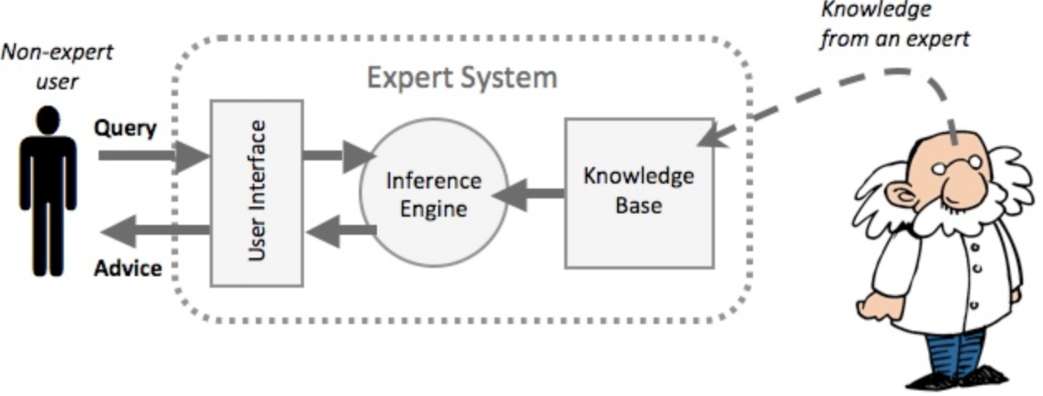
Expert Systems and Fuzzy inference
An expert system is an AI that solves problems by reasoning. An expert system has two components: a knowledge base and an inference engine
Most of the inference engines used in experts systems were built on fuzzy inference techniques
The most used fuzzy inference technique is the so-called Mamdani method.

Slide 31
Fuzzy inference (Mamdani method)
The fuzzy inference process is performed in four steps:
Fuzzification of the input variables,
Evaluation of fuzzy rules (i.e., rules on fuzzy numbers);
Aggregation of the rule outputs
Defuzzification.

Slide 32
Operation of Fuzzy System
Crisp Input
Fuzzification
Input Membership Functions
Fuzzy Input
Rule Evaluation
Fuzzy rules
Rule Output Aggregation
Fuzzy Output
Defuzzification
Output Membership Functions
Crisp Output

Slide 33
Two (crisp) input variables:
X is on a scale of 0 to 10, described using three fuzzy numbers:
A1 : project_funding is inadequate
A2: project_funding is marginal
A3: project_funding is adequate
Y is on a scale of 0 to 10, described using two fuzzy numbers:
B1: project_staffing is small
B2: project_staffing is large
Output (crisp) variable: Z = ? Z is on a scale of 0 to 100
C1: risk is low
C2: risk is normal
C3: risk is high

Slide 34
Step 1: Let’s define fuzzy numbers
A1 : project_funding is inadequate
A2: project_funding is marginal
A3: project_funding is adequate
B1: project_staffing is small
B2: project_staffing is large
C1: risk is low
C2: risk is normal
C3: risk is high

Slide 35
Step 2: Let’s define fuzzy rules on fuzzy numbers:
Rule: 1 Rule: 1
IF x is A3 IF project_funding is adequate
OR y is B1 OR project_staffing is small
THEN z is C1 THEN risk is low
Rule: 2 Rule: 2
IF x is A2 IF project_funding is marginal
AND y is B2 AND project_staffing is large
THEN z is C2 THEN risk is normal
Rule: 3 Rule: 3
IF x is A1 IF project_funding is inadequate
THEN z is C3 THEN risk is high

Slide 36
Step 3: Fuzzification
Take the crisp inputs, X and Y (project funding and project staffing)
Determine the degree to which these inputs belong to each fuzzy number.
The output is called fuzzy input

Slide 37
Suppose X (project funding) = 3 and Y (project staffing) = 6
project funding
project staffing
Fuzzy input: μ_{(x=A1)} = 0.5 μ_{(x=A2)} = 0.2 and μ_{(x=A3)} = 0 , μ_{(y=B1)} = 0.1 and μ_{(y=B2)} = 0.7

Slide 38
Step 4: Rule Evaluation
Apply the fuzzy input to the fuzzy rules.
To evaluate the disjunction of the rule inputs, we use the OR fuzzy operation.
μ_{A}∪_{B}(x) = max [μ_{A}(x), μ_{B}(x)]
To evaluate the conjunction of the rule inputs, we apply the AND fuzzy operation :
μ_{A}∩_{B}(x) = min [μ_{A}(x), μ_{B}(x)]

Slide 39
Mamdani-style rule evaluation
Fuzzified inputs:
μ_{(x=A1)} = 0.5
μ_{(x=A2)} = 0.2
μ_{(x=A3)} = 0 ,
μ_{(y=B1)} = 0.1
μ_{(y=B2)} = 0.7
Fuzzy output: z is C1 (0.1), z is C2 (0.2), and z is C3 (0.5),

Slide 40
Step 5: Aggregation of the Rule Outputs
We combine fuzzy outputs into a single fuzzy number.

Slide 41
Step 6: Defuzzification
The defuzzification process converts the aggregated fuzzy number to a single (crisp) number.
In other words, here we convert the fuzzy output to the crisp output for final presentation
Most popular defuzzification method is the centroid defuzzification.

Slide 42
Centroid defuzzification method finds a point representing the center of gravity of the fuzzy number, A, on the interval, ab.
A reasonable estimate can be obtained by calculating weighed sum over a sample of points.

Slide 43
Centre of gravity (COG):

Slide 44
Result
Two input variables:
project_funding = 3, on a scale of 0 to 10
project_staffing = 6, on a scale of 0 to 10
Output :
risk = 67.4 on a scale of 0 to 100

Slide 45
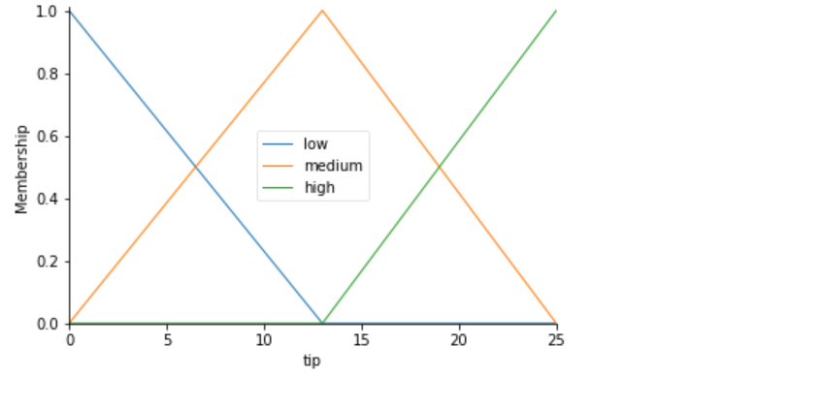
Lab: Implementing Fuzzy Control Systems using Fuzzy Inference
Scikit-fuzzy
Tipping problem

Slide 46
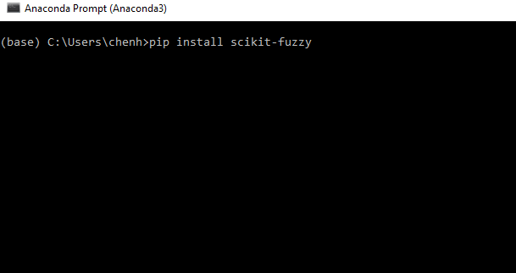
Install Scikit-fuzzy

